Slide 1
Brief Introduction of SocketPro Asynchronous Communication Framework for WAN
Request Streaming Sending and Processing for the Best Network Efficiency and Throughput
Yuancai (Charlie) Ye

Slide 2
Contents
Request Streaming Communication Pattern
SocketPro Architecture and Components
SocketPro Key Features
Node.js Demos
Client/server
Publish/subscribe
Persistent message queue
SQL-streaming
Master-slave with real-time updateable cache
File streaming
Analysis on nja.js + njadapter.node

Slide 3
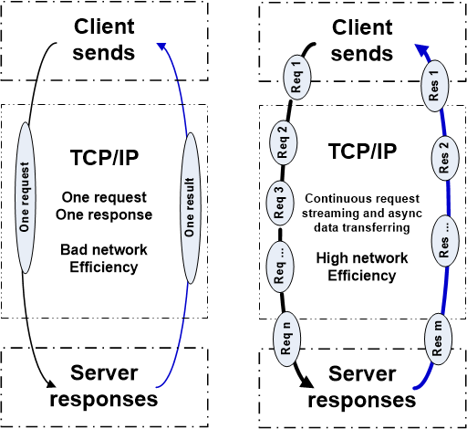
Two Basic Communication Patterns

Slide 4
SocketPro Communication Architecture and Components
Client Core
cross-platform
native code
Server Core
cross-platform
native code
Request batching and streaming, asynchrony, secure, parallel communication on TCP/IP
C++
Adapter
.Net
Adapter
Java
Adapter
Python
Adapter
JavaScript
Adapter
PHP
Adapter
Node.js
Adapter
C++
Adapter
.Net
Adapter
Python
Adapter
Java
Adapter
User Client Code
User Server Code

Slide 5
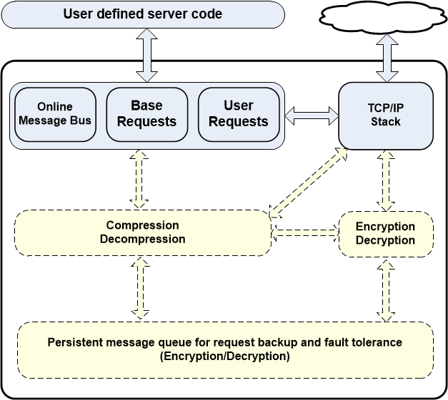
Client Core Features

Slide 6
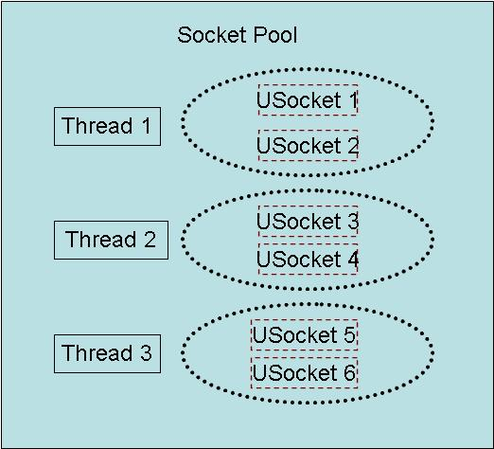
Client Socket Pool
A socket pool has three worker threads and each of these threads hosts two non-blocking sockets with fault tolerance for the best parallelism

Slide 7
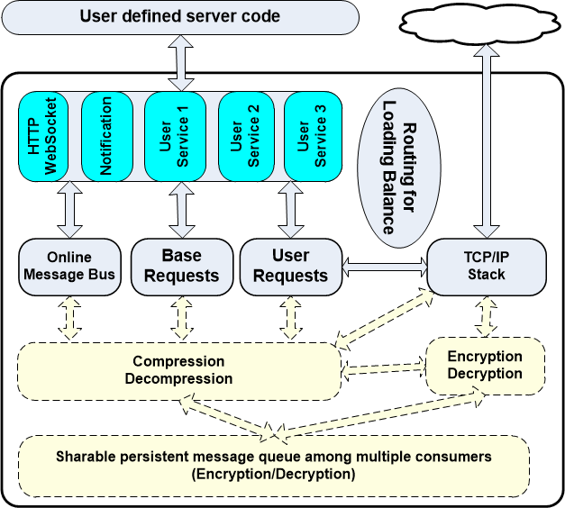
Server Core Features

Slide 8
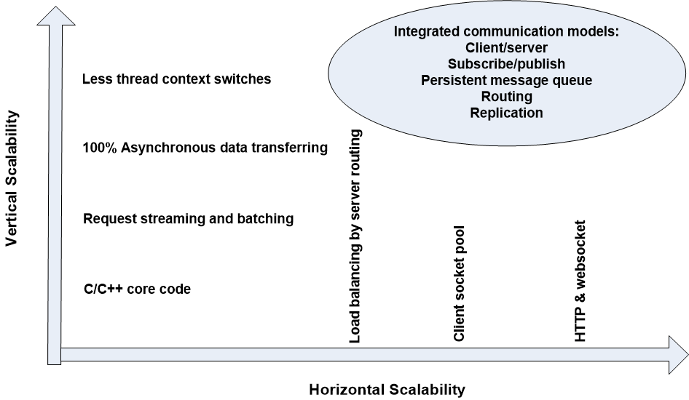
SocketPro Scalabilities

Slide 9
SocketPro Adapters for More Developers
C++ adapters – a few header and cpp files
One .NET adapter
Java adapter
Python adapter
Node.js adapter
One JavaScript adapter for browsers
PHP adapter in the future

Slide 10
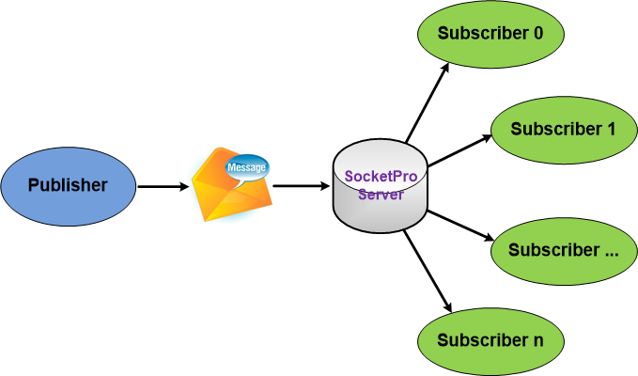
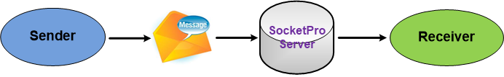
SocketPro Subscribe/Publish (Internet chat or online messaging)

Slide 11
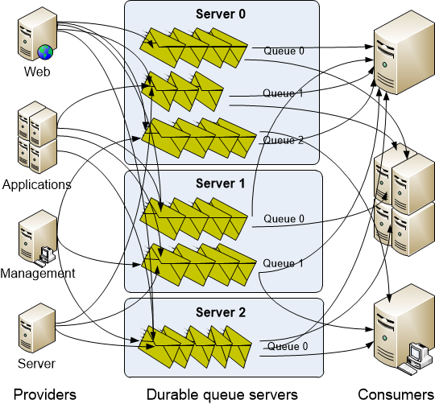
SocketPro Persistent Message Queue
Advantages of SocketPro over Kafka:
Manual transaction
Queue sharable among multiple consumers
Real-time message availability event (low latency)
No configuration settings
Faster than Kafka in message writing
Select a portion of requests to be queued persistently
No message loss as messages can be backed up at provider side

Slide 12
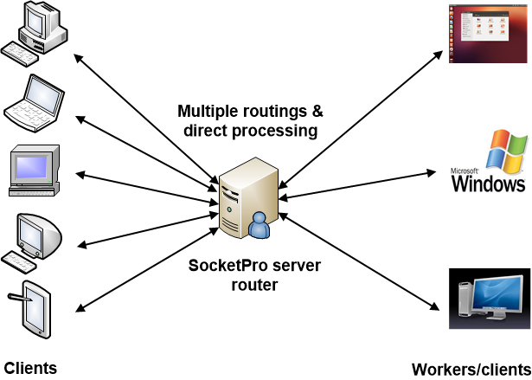
SocketPro Server Request Routing for Loading Balance with Fault Tolerance

Slide 13
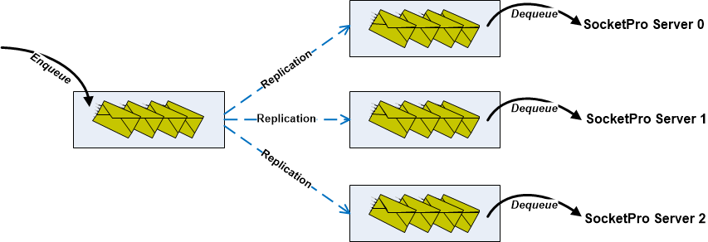
SocketPro Replication with ACID (Atomicity, Consistency, Isolation, Durability)

Slide 14
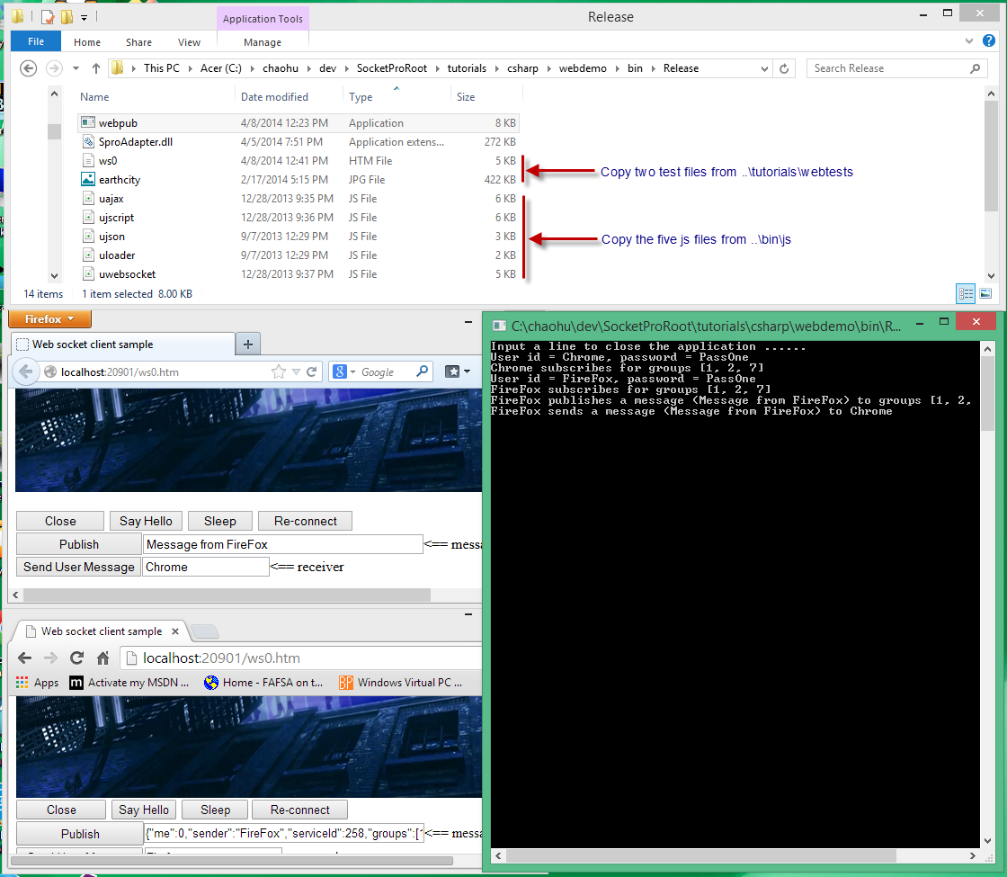
SocketPro HTTP/WebSocket

Slide 15
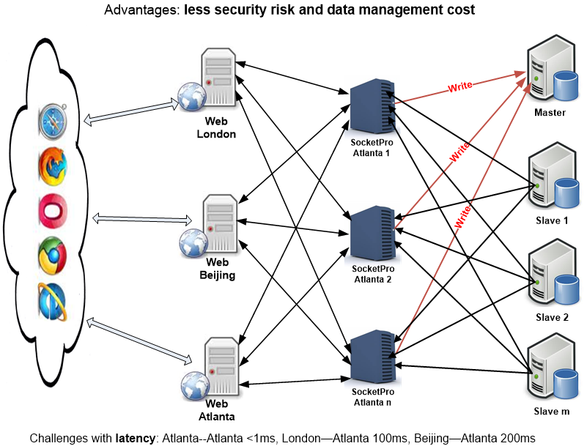
Global Web Systems by SocketPro

Slide 16
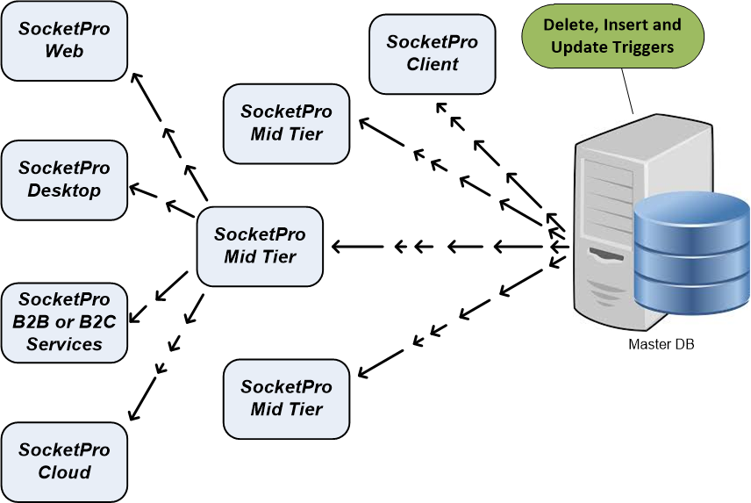
Real-time Updateable Cache

Slide 17
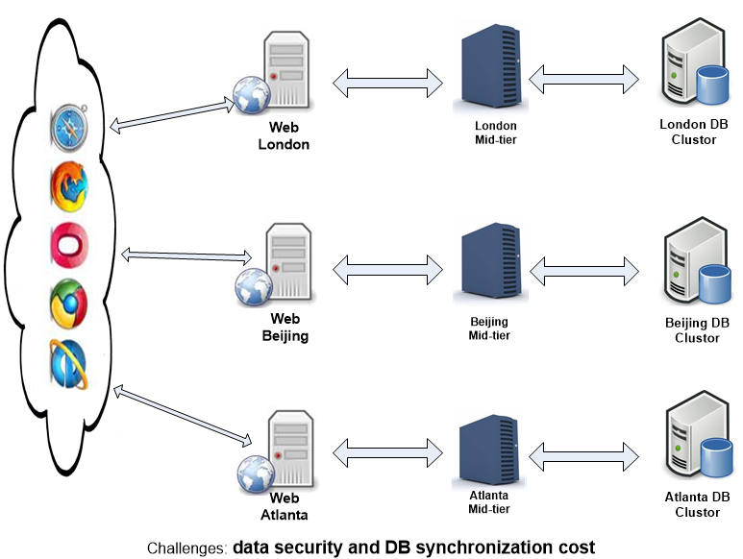
Global Web Systems by Common Approach

Slide 18
Simplification of design and architecture
(Async/await, integrated computation modes, freedom, flexibility and rich features)
Great for tough tasks
(Great UI response, cache, lots of items, unstable/slow WAN, threading, and stability)
Great integration
Unified but simple interfaces for different dev languages and Oss
Excellent with performance and scalability
+ Great interoperation among different environments
Simple but fast development

Slide 19
Demo for Client Server Pattern
Hello_world.js
Create and start one or more socket pools at client sides
Get an async handler for request streaming and returning result processing
Request data serialization and result processing
Streaming six requests and their results processing
Complex structure serialization and de-serialization
Async and await well supported with SocketPro node.js

Slide 20
Demo for Publish/Subscribe
Hello_world.js
Get a messenger (var messenger = hw.Socket.Push)
SendUserMessage
Send one message to one or more groups of listeners or clients
Catch messages from different message senders or publishers
Where subscribe happens ?
PoolEvent
ResultReturned
AllProcessed
BaseReqProcessed
ServerException

Slide 21
Demo for Persistent Message Queue
Server_Queue.js
Enqueue messages in streaming (sq.Enqueue)
Dequeue messages (sq.Dequeue)
Catch and parse dequeued messages (sq.ResultReturned)
Enqueue messages with manual transaction (sq.StartTrans and sq.EndTrans)
Batch small or tiny messages
Demonstration of async and await for a few queue requests

Slide 22
SQL-streaming Plugins
SQLite + cache
MySQL/Mariadb + Cache
MS SQL Server + Cache
ODBC for Any Databases
Postgresql + Cache in the Future
DB2 + Cache in the Future
Oracle + Cache in the Future

Slide 23
SQL-Streaming Demonstration
Sql_streaming.js
Open a database (db.Open)
Execute SQLs in streaming (db.Execute)
Prepare (db.Prepare)
Execute SQLs with multiple sets of parameters in streaming (db.Execute)
Large text and binary objects
Stored procedures with in, inout and out parameters
Execute all of them in batch and streaming (db.ExecuteBatch)
Demonstration of async and await for a few requests
One API for all relational database management systems

Slide 24
SQL-Streaming Performance Study
Perf_study/nja_perf.js and native_mysql.js
Performance study results:
WAN: 100 to 1000 times
LAN: 150% improvements
Cross-app in same machine: 30%

Slide 25
Demo For Master/Slave + Cache
Master_slave.js
Create a master socket pool (cs.newPool(SPA.SID.sidMysql, 'mysqldb’))
Access real-time updateable cache (var cache = master.Cache)
Execute writing SQL statements in streaming against one or more master databases
Find and access a table in cache
Common operations for a table in cache (Between, In, NotIn, Sort, EQ, LT, ……)
Create a slave socket pool object (var slave = master.NewSlave())
Start a slave socket pool
Execute queries (reading) in streaming against a set of slave databases

Slide 26
Demo For File Streaming
Remote_file.js
File plugin (free)
File download (file.Download)
File upload (file.Upload)
Downloading and uploading many files in file streaming
Demonstration of async and await for echoing a file
File downloading and uploading streaming vs traditional binary streaming
Great performance improvements for high volume of small or tiny files

Slide 27
Master/Slave + Cache + Requests Backup
webms/webpool.js & exp.js
Auto reconnecting
Turn on requests backup for all queries (reading) against slave databases (slave.QueueName = config.slave.queueName)
Enable auto merge (slave.AutoMerge = (config.slave.hosts.length > 1))
Best availability (maintenance, slave machines down, network down, etc)
No error handling required for reading queries against slave databases
Error handling required for writing SQLs against a master database (session closed)

Slide 28
Analysis of (nja.js + njadapter.node)
(Your js codes) ←→ (nja.js + njadapter.node) ←→ (usocket)
← Request streaming, asynchrony, secured communication in parallel →
(uservercore) ←→ (Your {C/C++|.NET|Java|Python} codes)
Platforms supported:
Windows
Linux variants
Window mobile device platforms
Android ?
Mac ?
Iphone ?

Slide 29
Questions ?
Thank you very much!

